Slide 1


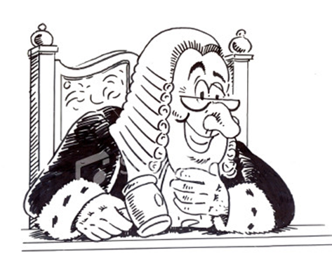
Title – Fair punishments?
Date:
Starter –
Write a list about ways which criminals are punished in 2016.
Why do we have punishments?

Slide 2
New Information
https://www.youtube.com/watch?v=e5yQVJV7SFs
How different are punishments in the medieval times from 2016?
LO: Describe punishments/explain opinion

Slide 3
Learning Activity
Punishment Description
LO: Describe punishments/explain opinion

Slide 4
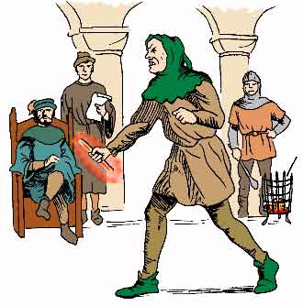
Ordeal by fire
An accused person held a red hot iron bar and walked three paces. His hand was then bandaged and left for three days. If the wound was getting better after three days, you were innocent. If the wound had clearly not got any better, you were guilty.
LO: Describe punishments/explain opinion
S Yelland KHS

Slide 5
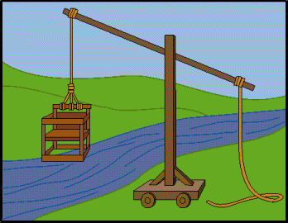
Ordeal by water
An accused person was tied up and thrown into water. If you floated you were guilty of the crime you were accused of.
LO: Describe punishments/explain opinion

Slide 6
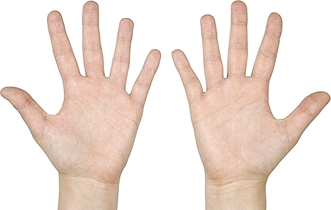
Mutilation
Cutting off parts of the body was common. A person who stole a purse might have their hand cut off; a person who had spread rumours could have their tongues cut out!
LO: Describe punishments/explain opinion

Slide 7
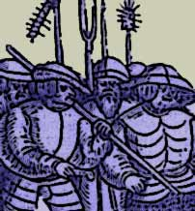
Hue and cry
A person being robbed or attacked or anyone who saw a crime had to raise the hue and cry by shouting something like ‘Stop thief’, or ‘Murder!’ Everyone within hearing had to leave what they were doing and give chase.
LO: Describe punishments/explain opinion

Slide 8
Demonstrate/Reflect
Using your red pen;
1. Which was the worst punishment and why? (30 words)
2. Do you think medieval punishments were fair? (20 words)
LO: Describe punishments/explain opinion

